Slide 1
Harvesting a Size Structured Ecosystem
Daniel Duplisea
Mark Bravington
CEFAS Lowestoft Laboratory
England

Slide 2
Purpose
To look for robust patterns in exploitatation strategy using two very different models of a size structured fish ecosystem
Notes:
We wanted to see if robust patterns of something we could potentially manage (F at size) would come out of models of very different levels of complexity and conception.
Where strategies are similar, it indicates that similarities in the structure of the models are probably the important processes to include in any model of the system
Where strategies differ, then it indicates that there are structural differences in the model which are going to affect the robustness of your advice. Then the models have to be re-evaluated to see where these differences occur and how important you think they are.

Slide 3
Models and Methods
Model 1
length-cohort model with 10 species that are linked via predation mortality
Model 2
biomass size-spectrum mass conservation model
Method
for each model determine an optimal size-based fishing strategy which maximised equilibrium yield
Notes:
Model 1
MSFOR type model
all predators achieve their ration all the time
all species eat all others including cannibalism
predators always eat prey smaller than themselves but not in a fixed size ratio (realistic for small prey but not large prey. Log size classes would be a better way to do it. Also fixed pred/prey size ratio could be modelled but this was computationally much simpler for a first attempt).
Model 2
biomass size spectrum energy flow model.
everything moves up the spectrum
predation is modelled with a pred/prey size ratio
growth is variable and is dependent on food intake
reproduction is ignored
Method
a 2-4 point F at size fishing strategy was run which maximised the equilibrium yield.

Slide 4
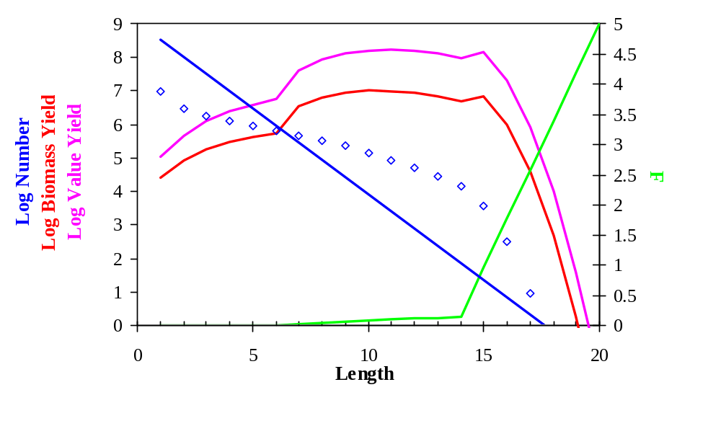
Length-Cohort Model
Notes:
The dots are the numbers at size points and the blue line is the least squares regression
The units in the model are arbitrary but they are internally consistent

Slide 5
length-cohort model Results
a linear unexploited community size structure resulted
with almost any type of exploitation, the community size spectrum got steeper
the optimal fishing strategy was small F on small sizes and large F on large sizes
Notes:
The numbers size spectrum slope dependent on the mix of species types
The size spectrum slopes tend to be steeper than empirical slopes and respond more readily to exploitation
The diversity size spectrum (not pictured) does not respond consistently to exploitation
This strategy was true whether it was total biomass yield or total value yield that was maximised

Slide 6
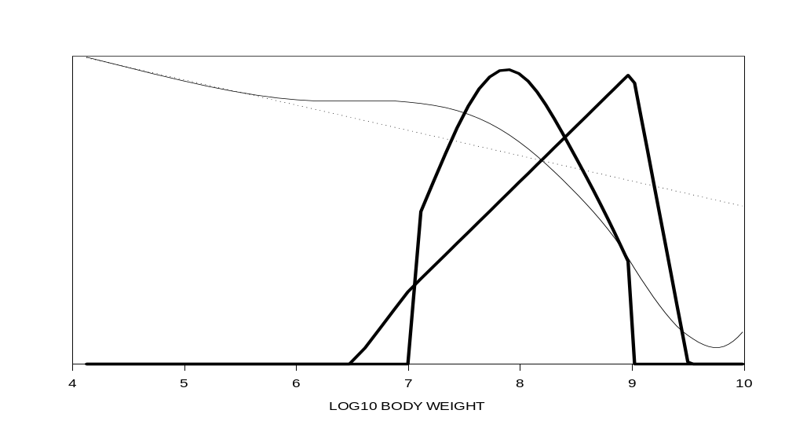
Biomass Size-Spectrum Model
Notes:
Units are a bit arbitrary but internally consistent

Slide 7
biomass size-spectrum model Results
Fishing caused a large decrease in biomass of fish in the fishable size range
the optimal fishing strategy was small F on small sizes and large F on large sizes
Notes:
This strategy was true whether it was total biomass yield or total value yield that was maximised.

Slide 8
General Points
Both models suggested a similar optimal fishing strategy which maximised equilibrium yield
Mechanisms leading to this are in size dependent growth and predation:
  remove the large predators from the system and exploit this surplus yield in the fishery
  the production of the smaller fish is higher than the larger fish, so keep the system small
Notes:
The models are of very different conception yet similar strategies
VPA accounting type model
vs
energy based size-spectrum model
The mechanisms in the slide are what account for this
The increase in value yield resulting from increased fish production is greater than the loss in value yield by removing all the large and more valuable fish
The cost of effort was not taken into account but a simple simulation indicated that when effort cost was taken into account, the same overall pattern held but that the F at size curve was flatter.

